Slide 1

Federated GNNs Learning from Dynamic Graphs for Traffic Forecasting.
Muhammad Usman

Slide 2

Agenda
Outcomes
Problem intro
Data Collection
Methodology
Preliminary Analysis
Roadmap – Further Plaining
Real Time application Design

Slide 3
Problem Intro
Forecasting Real-time Traffic Speed For A Specific Future Timestamp.
Federated GNN Learning
Why? Traffic forecasting enhances urban livability, sustainability, and efficiency by guiding decisions on transportation, infrastructure, environment, and economy.

Slide 4
Data Sources
METR_LA
PEMS_Bay

Slide 5
More about datasets
Metr_LA : A traffic forecasting dataset based on Los Angeles metropolitan traffic conditions. The dataset contains traffic readings collected from 207 loop detectors on highways in Los Angeles county in aggregated 5-minute intervals for 4 months between March 2012 to June 2012.
PEMS-BAY: This traffic dataset is collected by California transportation agencies (Caltrans) performance measurement system (PEMS). It is represented by a network of 325 traffic sensors in the bay area with 6 months of traffic readings ranging from Jan 1st 2017 to may 31th 2017 in 5 minute intervals.

Slide 6
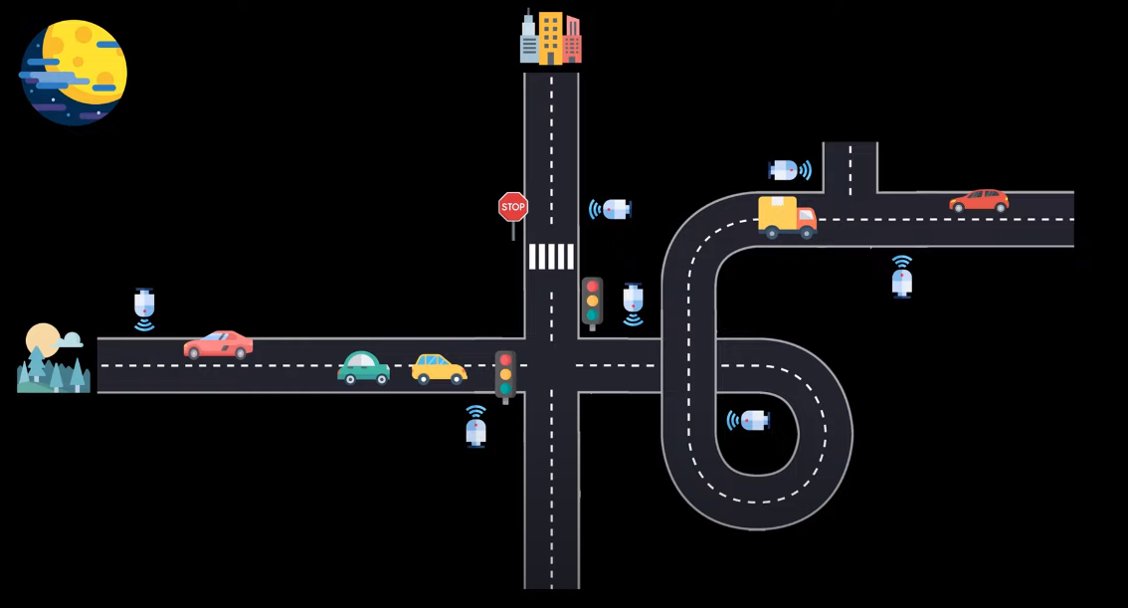
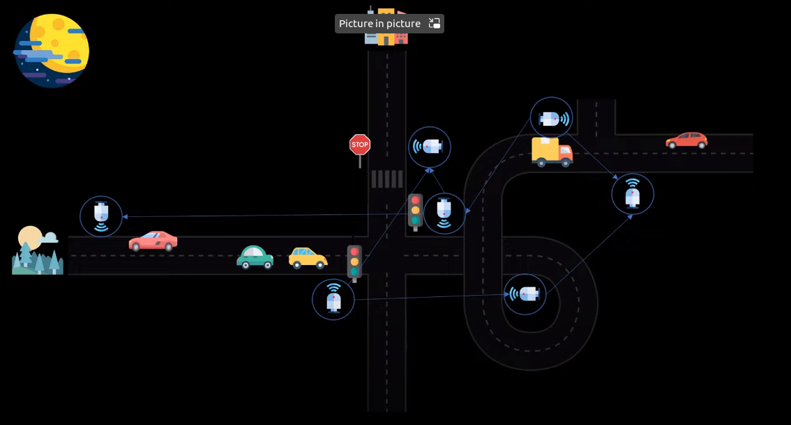
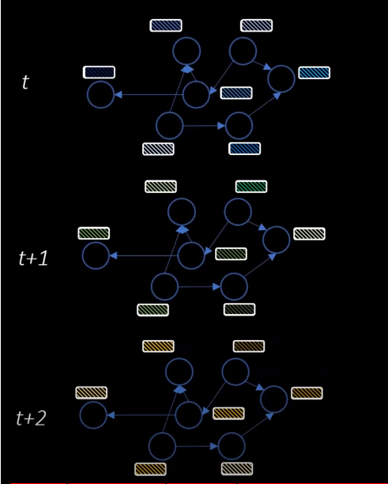
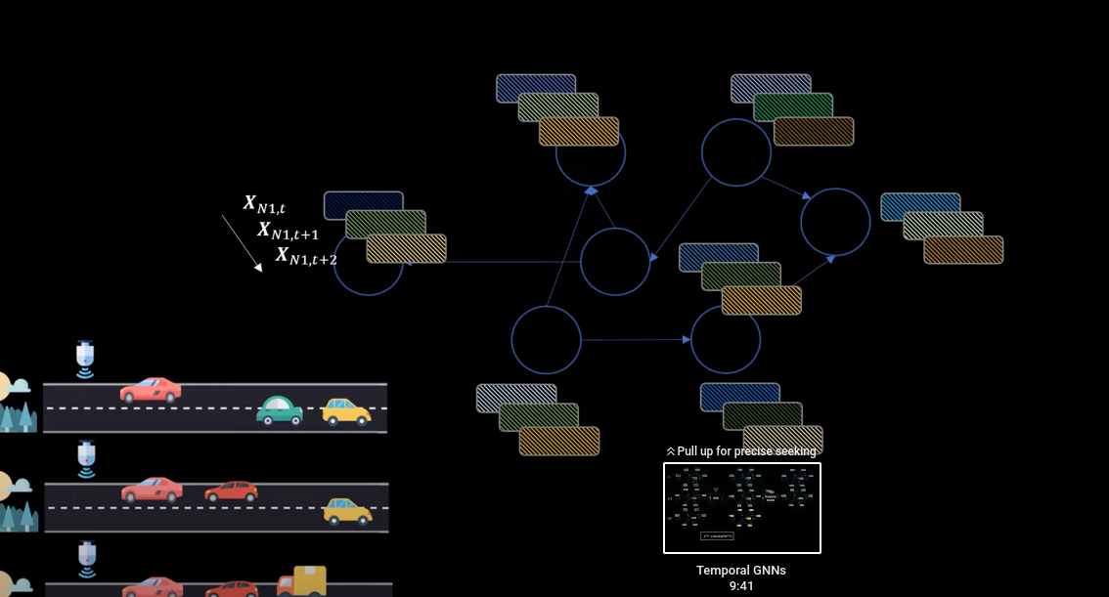
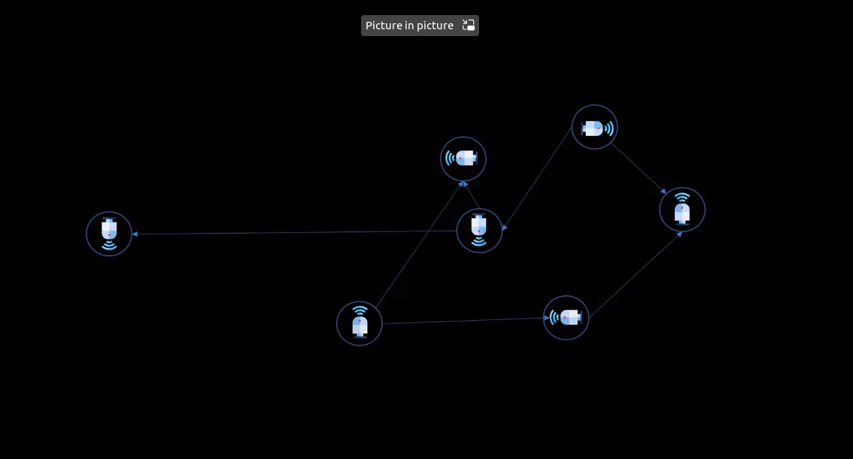
How the Metr_LA Dataset is constructed.

Slide 7
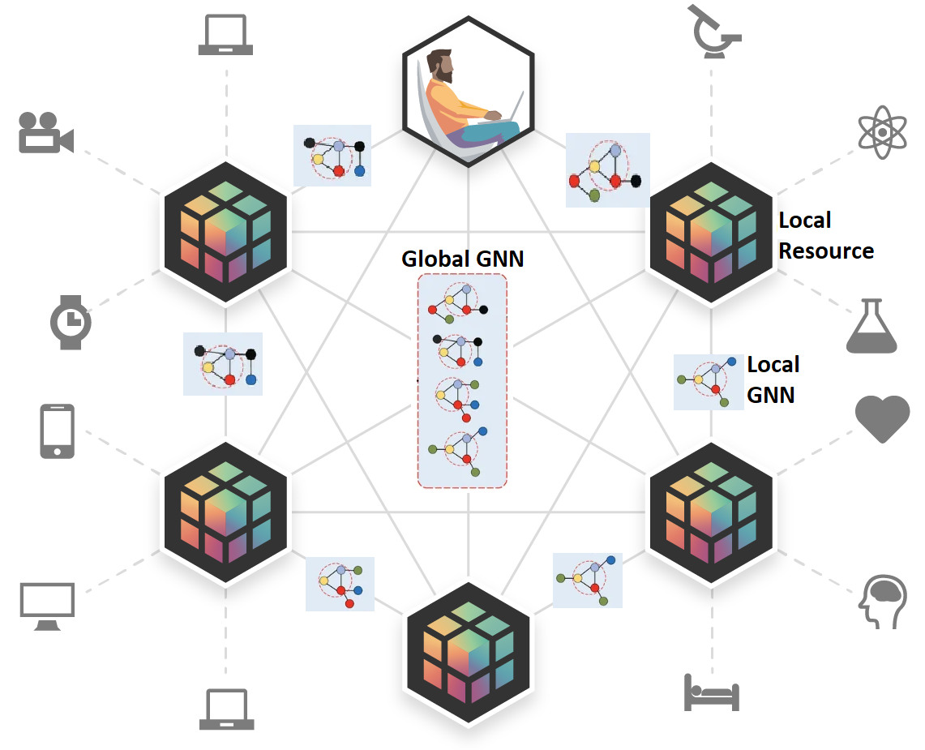
Federated GNNs Learning

Slide 8
Our Methodologies
Dynamic Graph Normalization
Generate Graph Level Embeddings
Unsupervised Partitioning
Federated GNN Training
Evaluation(MAE,RMSE,MAPE)
Client Grouping
Adaptive Boosting
Ordinary Differential Equations.

Slide 9
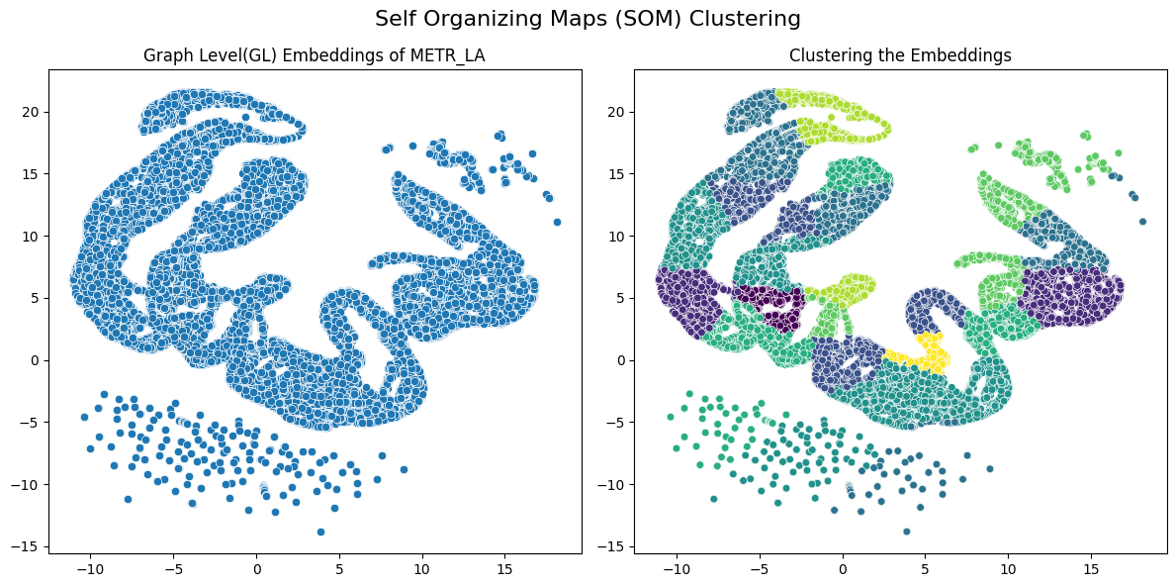
Preliminary Analysis

Slide 10
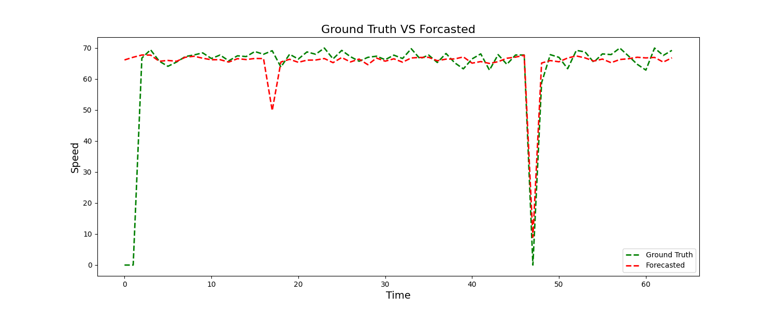
Preliminary Analysis

Slide 11
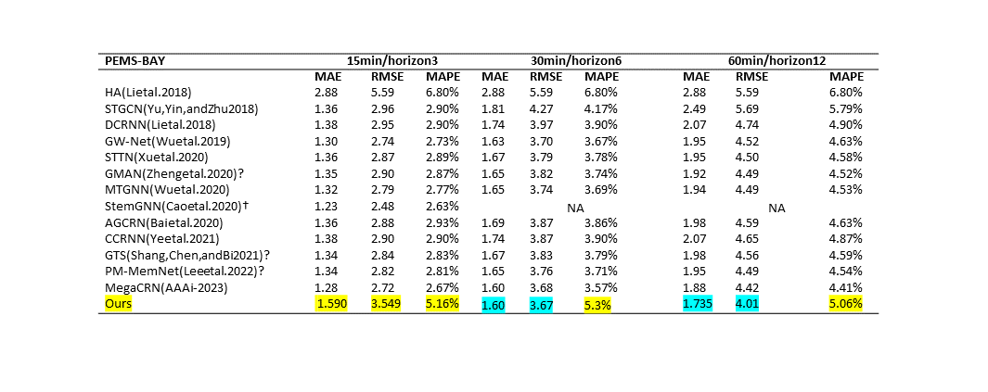
Cross Validated on PEMS_Bay

Slide 12
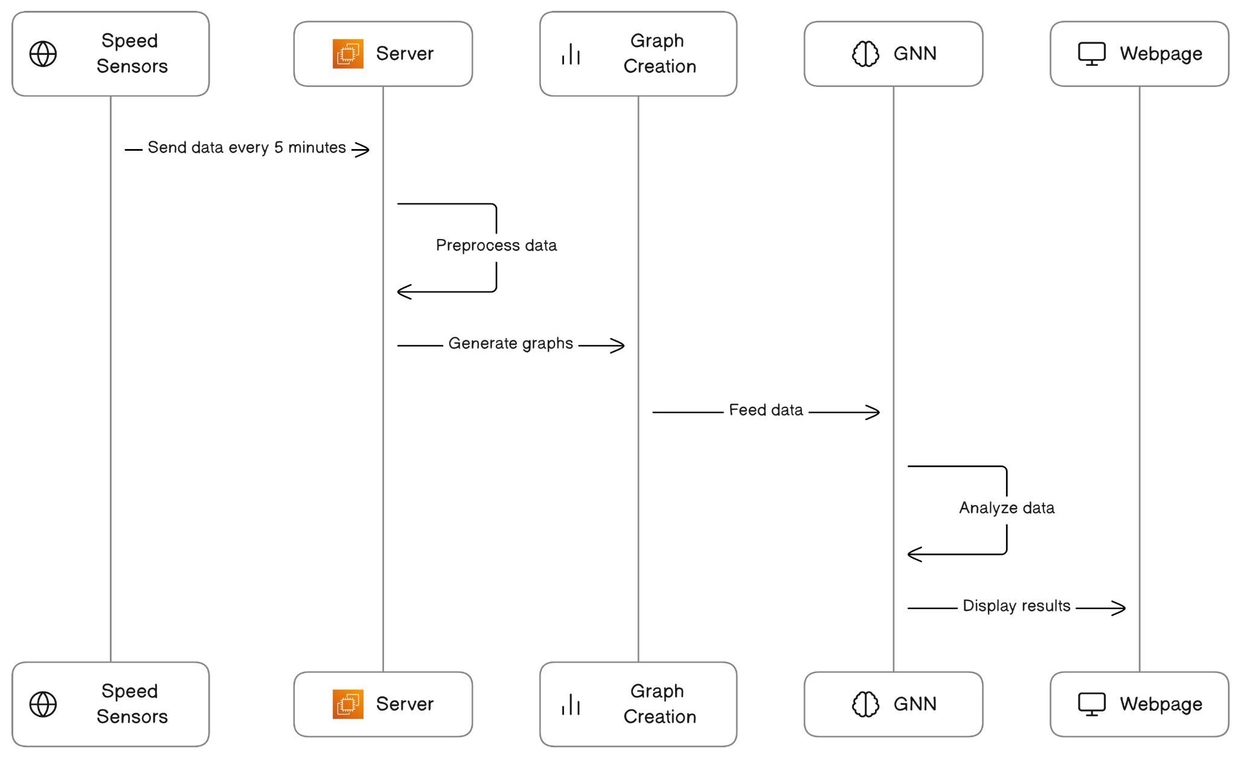
Real time Application Design

Slide 13
Roadmap - Expectations
Cross validation of the methodology
on [ 3, 5, 12] minutes of traffic forecasting
PEMS_Bay and Metr_LA
Evaluation(MAE,RMSE,MAPE)
Ablation study.

Slide 14
Outcome
A publication in either the AAAI (2024) or KDD (2024) conference.

